Slide 1

TradeWave-Stock Market Tracker

Slide 2
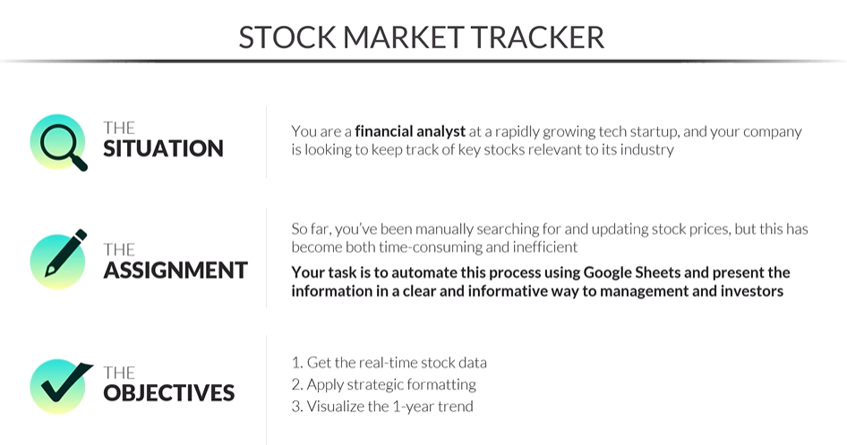
Used GOOGLEFINANCE()

Slide 3
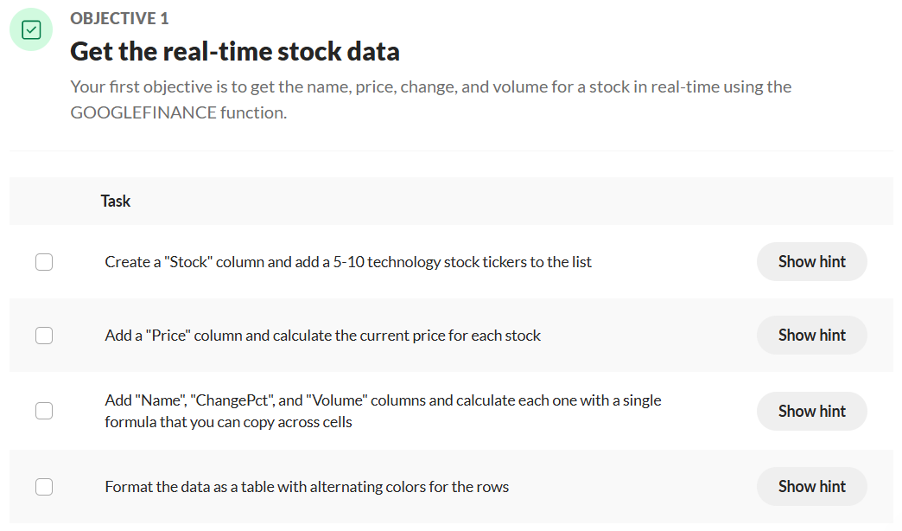

Slide 4
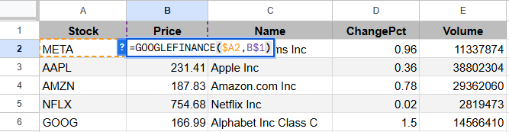
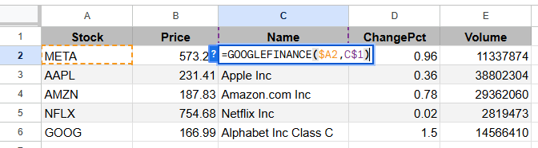
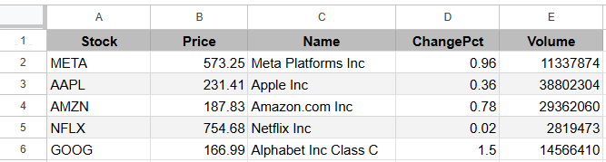


Slide 5
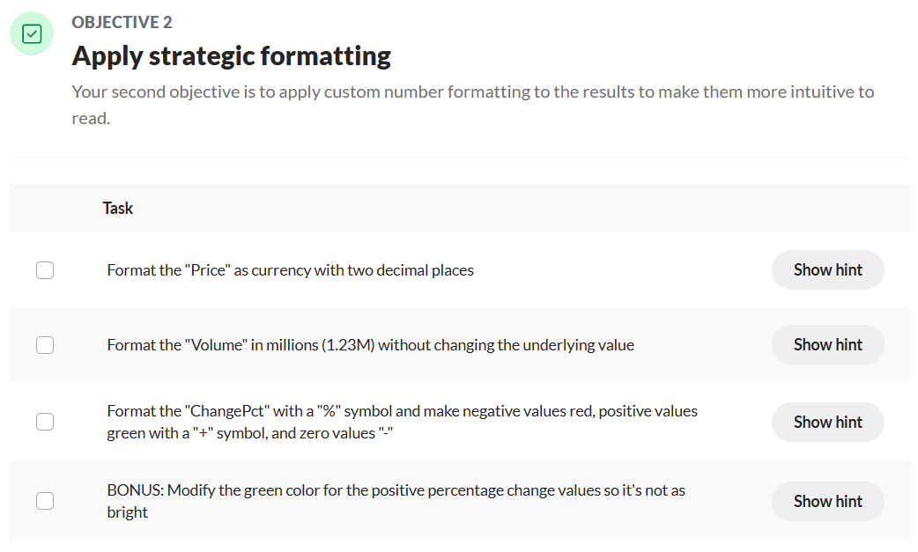

Slide 6
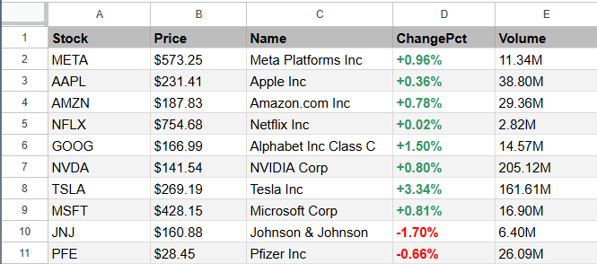

Slide 7
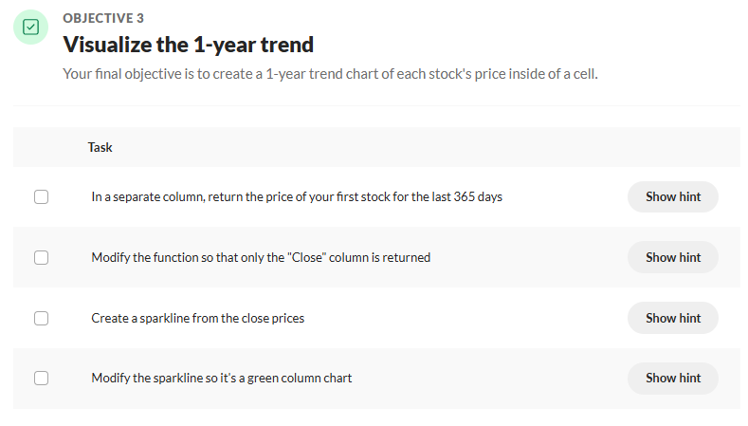

Slide 8
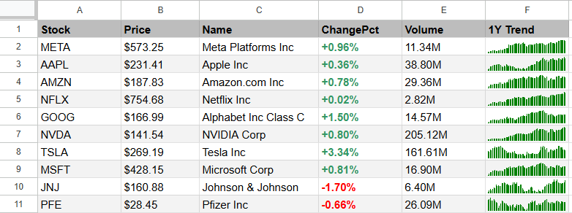
=SPARKLINE(INDEX(GOOGLEFINANCE(A2,"price",TODAY()-365,TODAY()),,2),{"charttype","column";"color","green"})
TradeWave

Slide 9


